Slide 1
Nonprofit Explorer from ProPublica: A 360 View for Prospect Researchers to Maximize Value from This Free Resource
Roger Magnus
Roger Magnus Research
Amherst, MA
413-687-8466
www.rogermagnusresearch.com
roger@rogermagnusresearch.com
https://www.linkedin.com/in/rogermagnus/

Slide 2
Overview
- What is ProPublica Nonprofit Explorer?
- Basic Search (Organization, Keyword, People)
- Advanced Search
- Search Problems and Strengths
- Questions

Slide 3
What is ProPublica NonProfit Explorer?
- ProPublica is an investigative journalism site (See https://www.propublica.org/about/)
- 3 Million nonprofit and foundation tax returns
- 2013 – 2022 (can go back to 2001)
- Formats: PDF and digital
- Types of Nonprofits: 27
Source: https://projects.propublica.org/nonprofits/ -> About This Data (right side of page towards bottom)

Slide 4
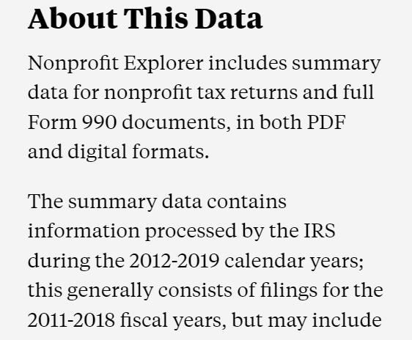
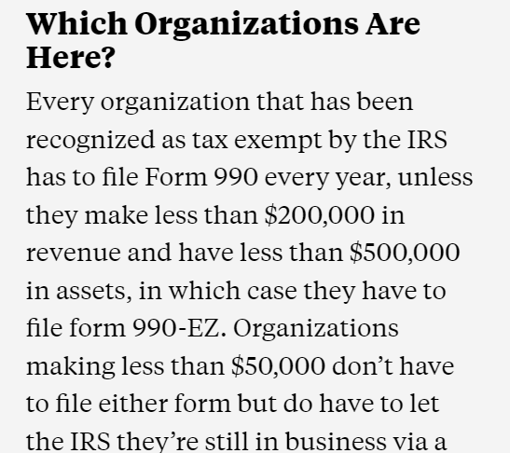
What is ProPublica NonProfit Explorer?

Slide 5
Basic Search
Website: https://projects.propublica.org/nonprofits/
(OR on main page - https://www.propublica.org/ -> link in upper left-hand corner)
Three Ways to Search:
Organization
People
Keyword

Slide 6
Basic Search – Search by Organization
Enter name, keyword, OR city
State
Major Nonprofit Category (11)
Org. Type (27)

Slide 7
Basic Search – Search by Organization
Enter name, keyword, city

Slide 8
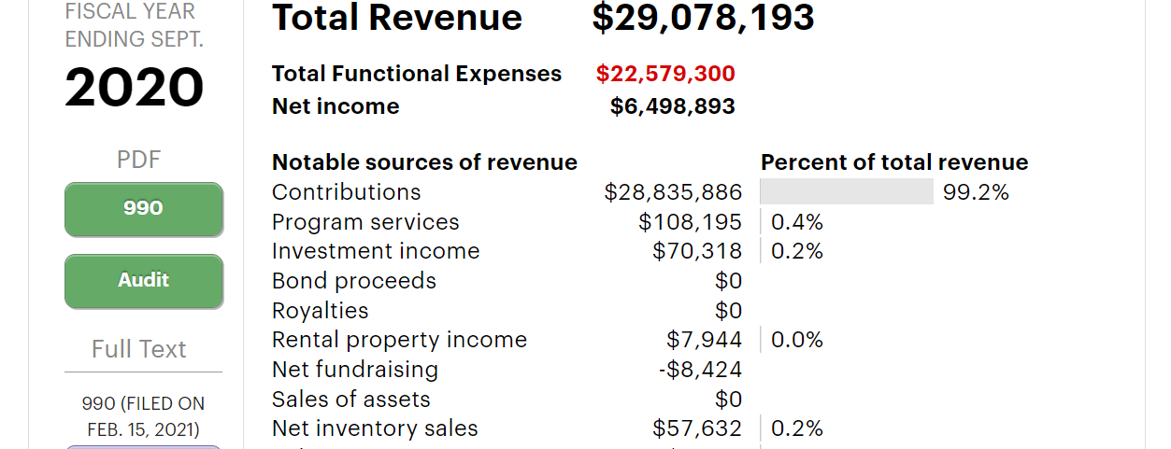
Basic Search – Search by Organization
Enter name, keyword, city

Slide 9
Basic Search – Search by Organization
Enter name, keyword, city

Slide 10
Basic Search – Search by Organization
Enter name, keyword, city
243 Results

Slide 11
Basic Search – Search for Officers or Employees
Notes:
Searching for Ward Caswell, President and Board Member the Beveridge Foundation and board members of several other nonprofits. . This part searches sections of a 990 or 990 PF form that pertain to executives or board members. For the executives (and certain other highly paid employees), at most only the top 20 are listed and often much less depending on compensation. Note that sometimes these individuals are not listed by their full names but rather initials for first or middle name. If you search on Caswell by itself, you get over 1200 entries.

Slide 12
Basic Search – Full-Text Search
Some Ways to Use:
New Foundation Funding: Search on a nonprofit that has received foundation funding/search for relationships between nonprofits and foundations.
Search for People: Results organized differently and may go back further than People search.
Location search (Advanced Search works better)
Search for other types of nonprofits besides 501(c)(3)’s, e.g. ((501(c)(4)) (Advanced Search better)
Notes:
Note: This search option sometimes just brings up a particular section of a tax form and not the whole thing. May need to re-do the search in Organization to see if for example the foundation accepts unsolicited grant applications.

Slide 13
Basic Search – Full-Text Search
Notes:
Tip: The nonprofit will also be listed if you want to search on it and its funders.

Slide 14
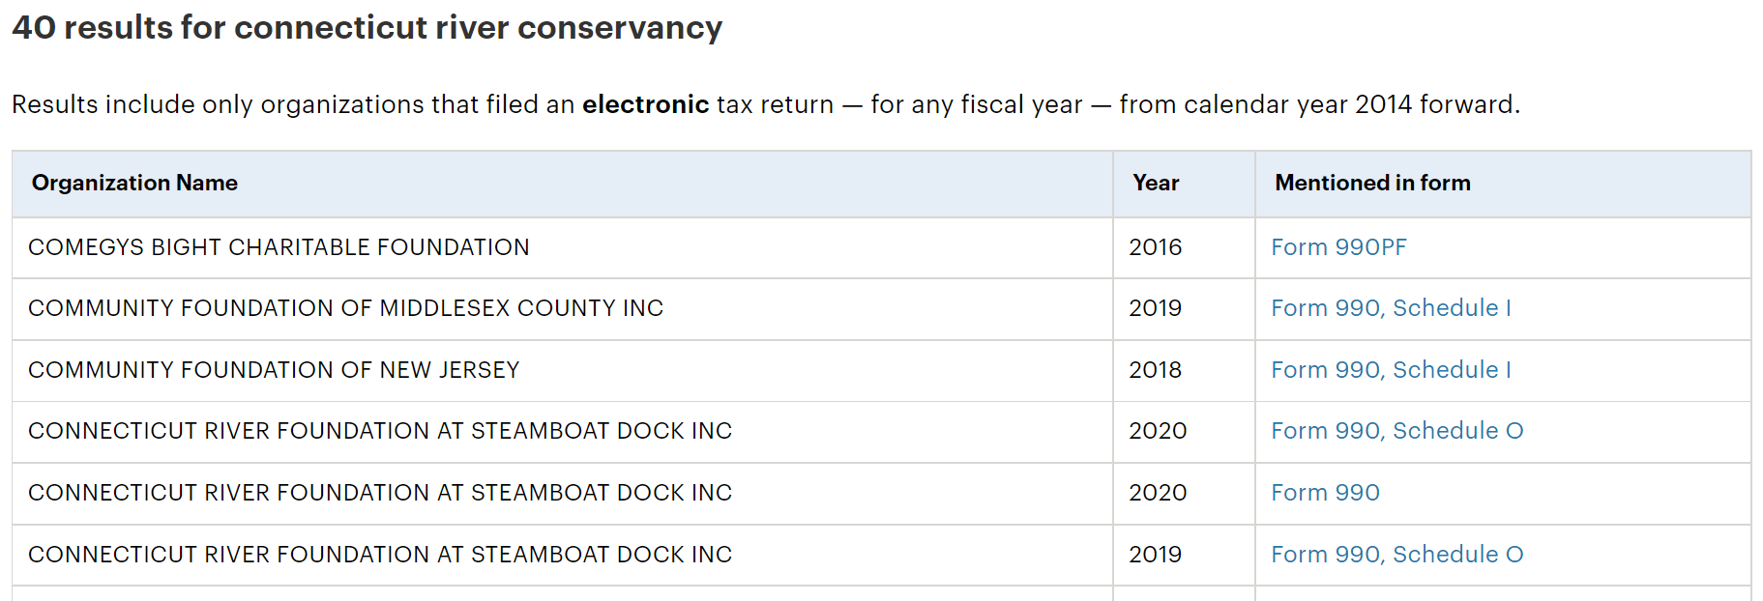
Basic Search – Full-Text Search

Slide 15
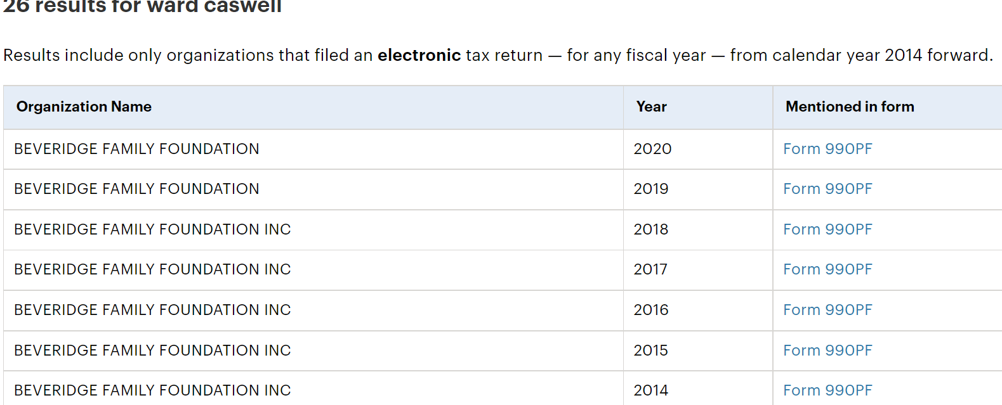
Basic Search – Full-Text Search

Slide 16
Basic Search – Full-Text Search

Slide 17
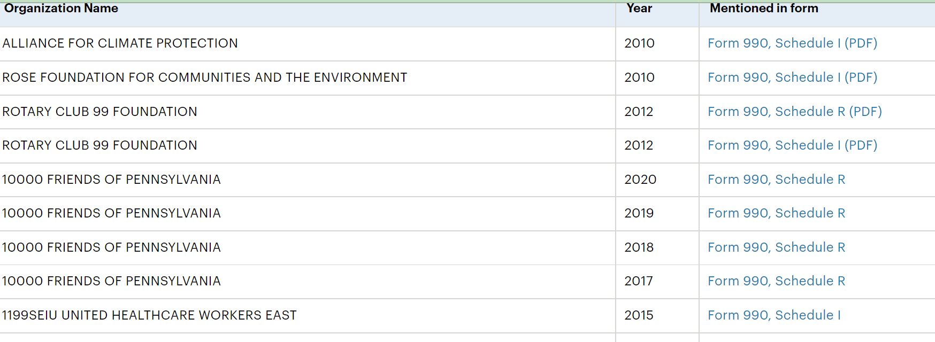
Basic Search – Full-Text Search

Slide 18
Basic Search – Full-Text Search
Ex. Alaska Conservation Foundation

Slide 19
Advanced Search
Website: https://projects.propublica.org/nonprofits/advanced_search
OR from People Search -> Advanced Search link
4 Ways to Search:
Find Officers or High Paid Employees (Same as Basic Search – People)
Find Any Word or Phrase in an Electronic Filing (Same as Basic Search – Full-Text Search)
Go Directly to a Nonprofit Profile (EIN)
**Find a Nonprofit by ...
all words, exact word, any word, no words – title search
City, state, category, organization type

Slide 20
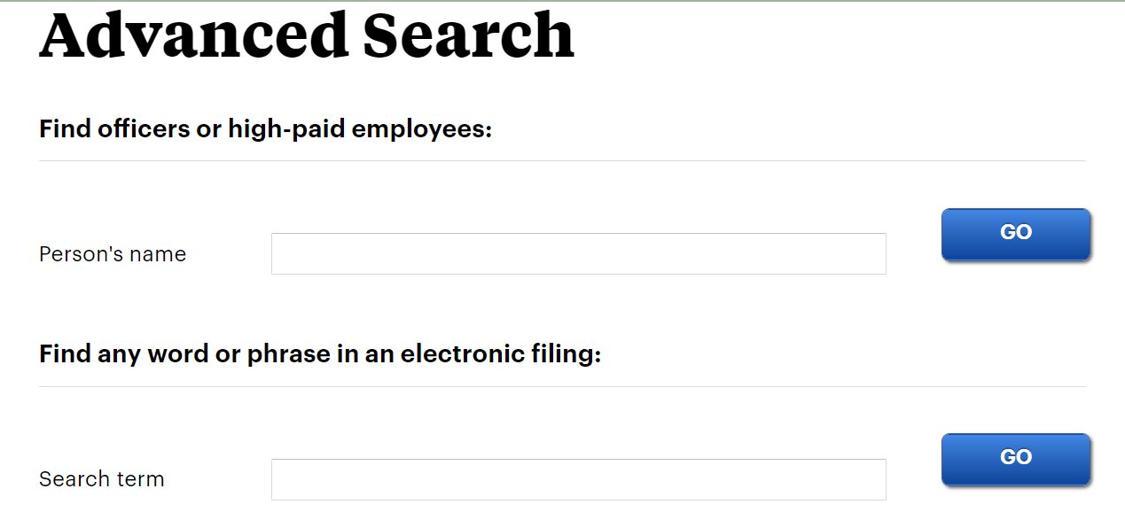
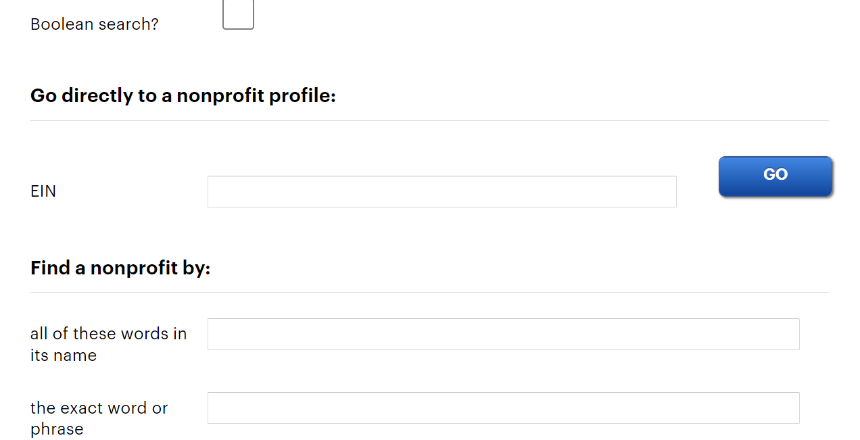
Advanced Search

Slide 21
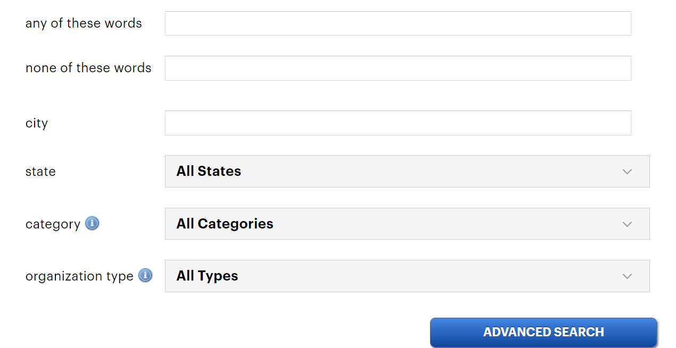
Advanced Search

Slide 22
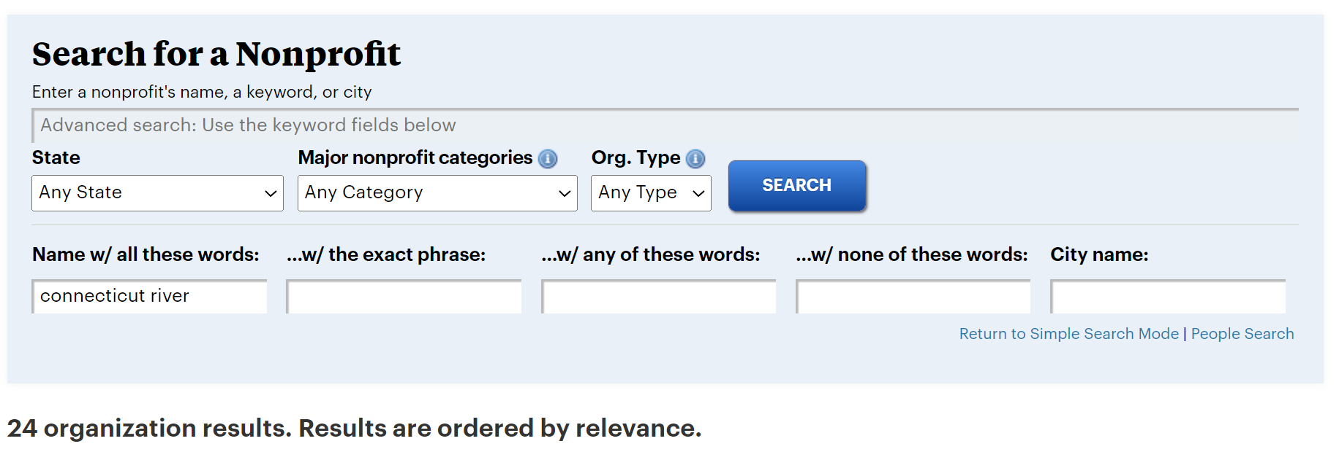
Advanced Search
Find a Nonprofit by All of These Words in Its Name:

Slide 23
Advanced Search
The exact word or phrase:

Slide 24
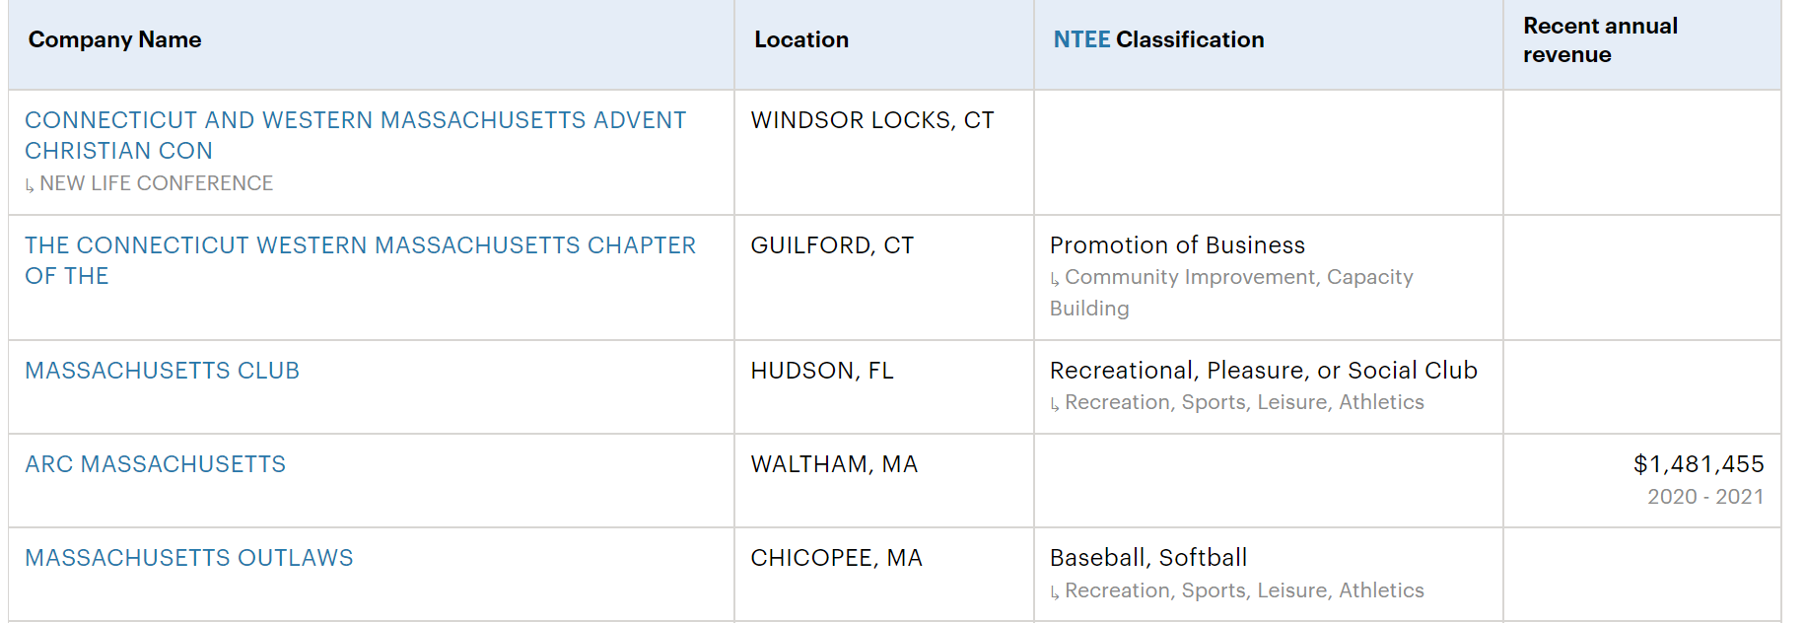
Advanced Search
Any of these words:

Slide 25
Advanced Search
None of these words:

Slide 26
Advanced Search
None of these words:

Slide 27
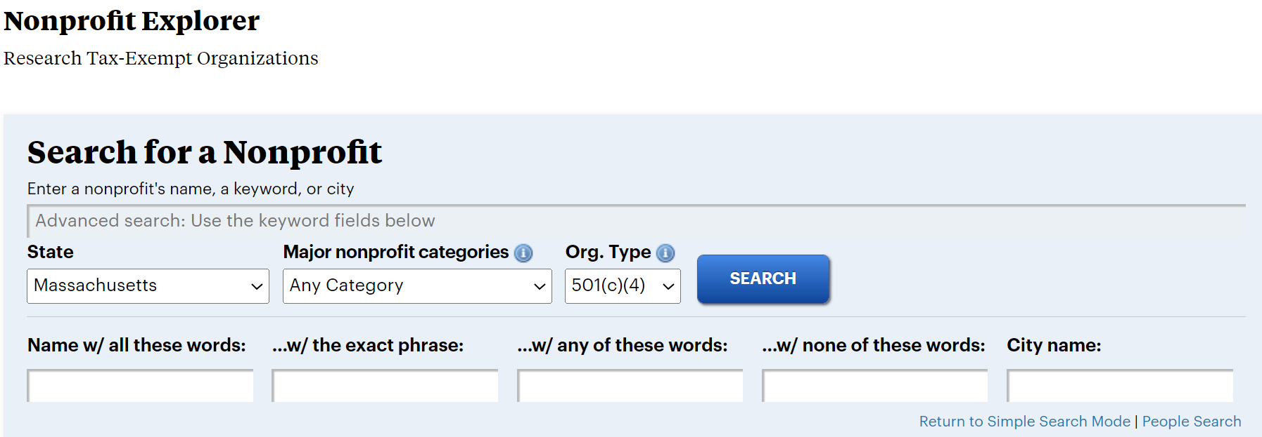
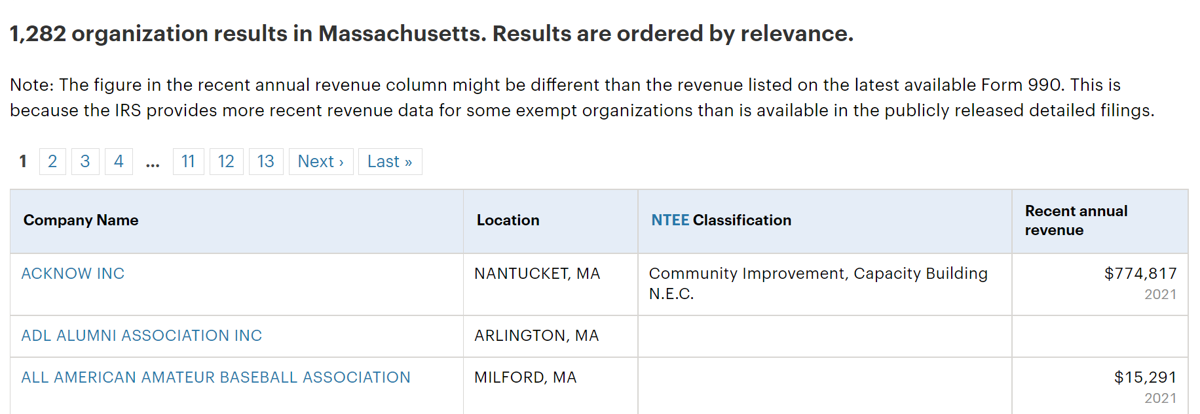
Advanced Search
State/Org. Type:

Slide 28
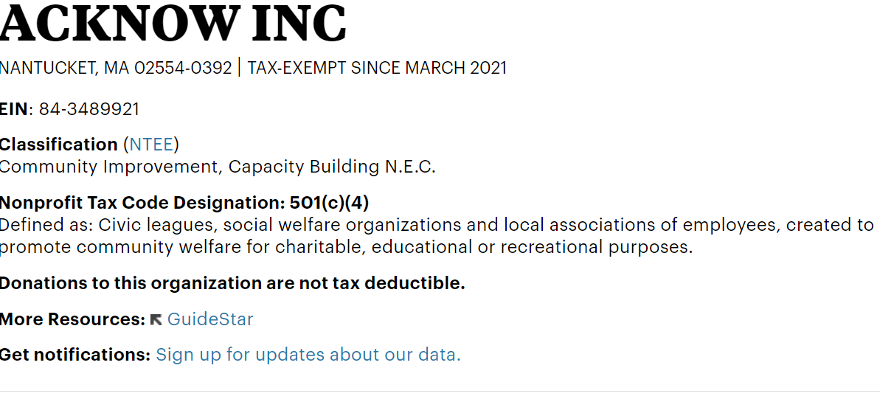
Advanced Search

Slide 29
Advanced Search
State/Org. Type/City Name:

Slide 30
Advanced Search
State/Org. Type/City Name/Category:

Slide 31
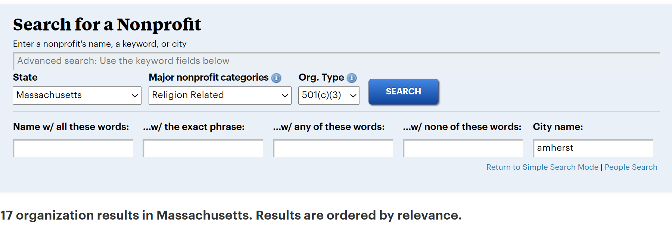
Advanced Search
State/Org. Type/City Name/Category:

Slide 32
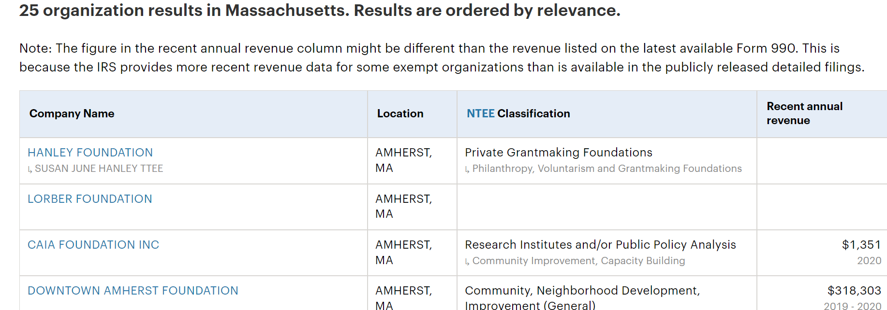
Advanced Search
State/Org. Type/All Words/City Name

Slide 33
Search Problems with Website
- **Finding Advanced Search
- Cannot limit by date - Basic or Advanced Search
- Cannot limit to searching on a Foundation
**Searching by Zip Code (except in Keyword search, which yields many tangential hits)
Multiple Words/Boolean Search in Keyword Search – Basic or Advanced Search (However, Quotes work fine.)

Slide 34
Search Problems with Website - More
Advanced Search: Categories and Types of Nonprofits only one option
Results are only 100 per screen and cannot be downloaded directly into spreadsheet software for further intelligence of results
Keyword Search and Advanced Search – Find a Nonprofit by … work differently - distinction is not always clear

Slide 35
Applications: Search Strengths
* Finding foundation funders for nonprofits (and other one word or phrase keyword searches in Basic Search - Keyword)
Historical Nonprofit and Foundation tax forms
People Search (though cannot limit by geography with a common name)
Creating targeted list of nonprofits – By geography/type of nonprofit (find lists for types other than 501(C)(3)s /category (though can search ONLY one at a time)

Slide 36
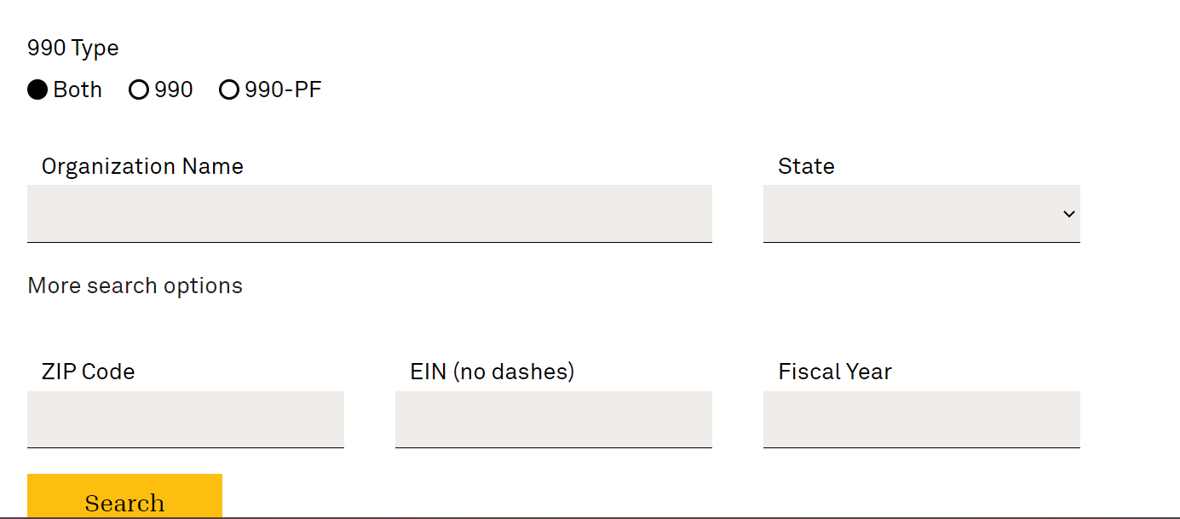
Comparison to Another FREE Resource: 990 Finder (Candid)
990 Finder – https://candid.org/research-and-verify-nonprofits/990-finder
Can find by Zip Code
Can limit by 990PF form

Slide 37
Questions??
Thank you!!
Roger Magnus
Roger Magnus Research
Amherst, MA
413-687-8466 (Call/Text)
roger@rogermagnusresearch.com
www.rogermagnusresearch.com
https://www.linkedin.com/in/rogermagnus/

